Slide 1
Manual for
Home-build AFM
Bio-mechanics Lab
Lehigh University
Xiaohui (Frank) Zhang
Wei Zhang

Slide 2
Procedure
Step 1: Turn on AFM controller; run Igor (afm-includeAll).
Step 2: Calibration
Step 3: Pulling Experiment

Slide 3
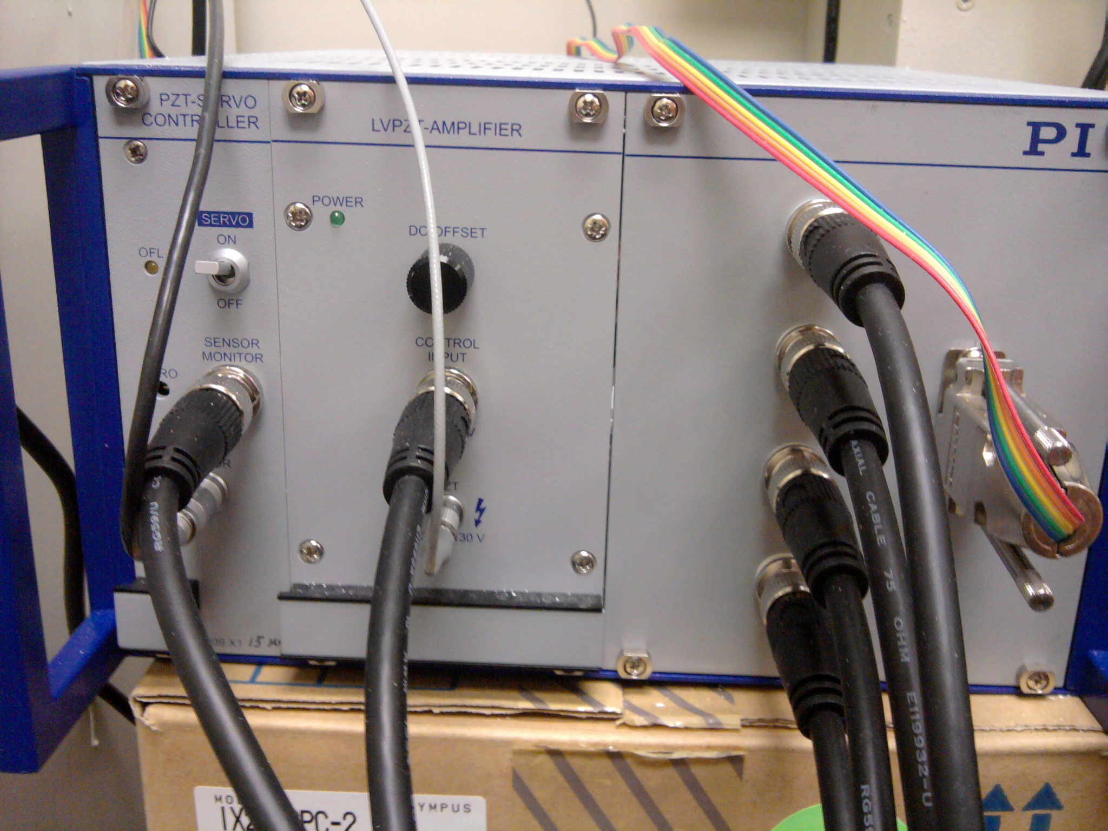
Step 1 – Turn on AFM Controller

Slide 4
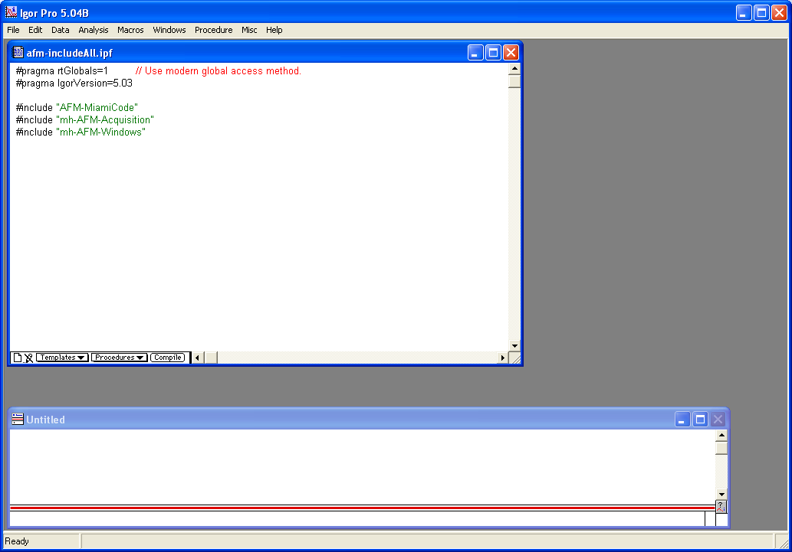
Step 1 – Run Igor (afm-includeAll)
Click Compile;
Go to Macros -> Init
Compile first

Slide 5
Step 2 - Calibration
Before Calibration:
Mount the holder to the AFM piezo properly.
Align the laser, to make the laser shot into the photodetector.
Keep the holder far from the dish surface when doing the sample scan.

Slide 6
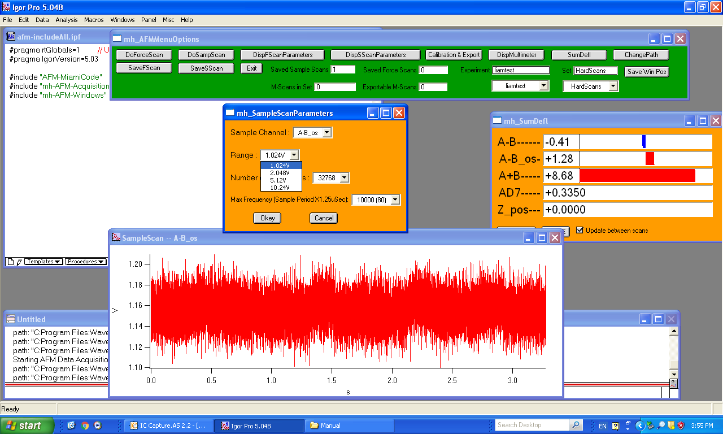


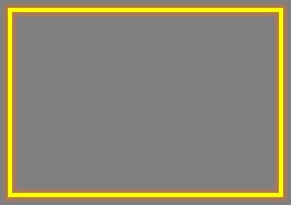
Step 2 – Calibration: Sample Scan
Sample Scan Parameters:
Range: 1.024 V (default)
Change to a higher value when necessary, for example, when using a smaller cantilever.
Save at least 5 good sample scans.

Slide 7
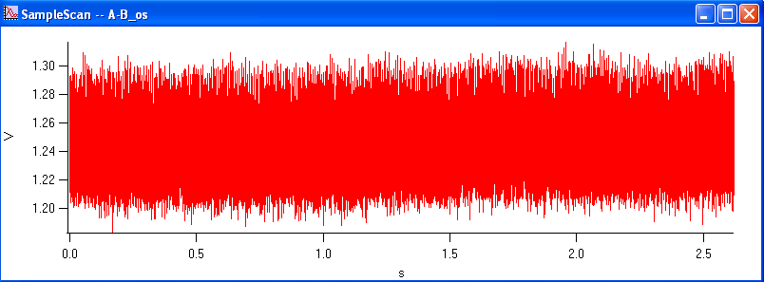
Step 2 – Calibration: Sample Scan
An example of good Sample Scan.

Slide 8
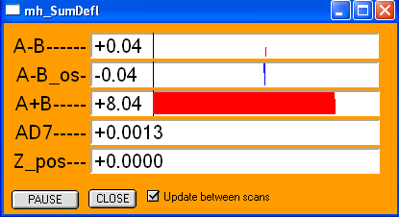
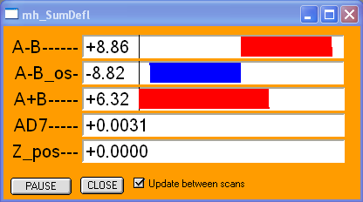
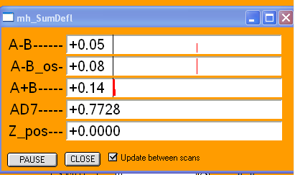
Step 2 – Calibration: Hard Scan
Approach the cantilever to the dish surface first.
Check the sensitivity of the reflection signal.
Beginning: cantilever is far from dish surface.
Cantilever touches dish surface. (signal jumps)
Cantilever continues to move down a little. (signal disappears) Lift it back immediately!

Slide 9
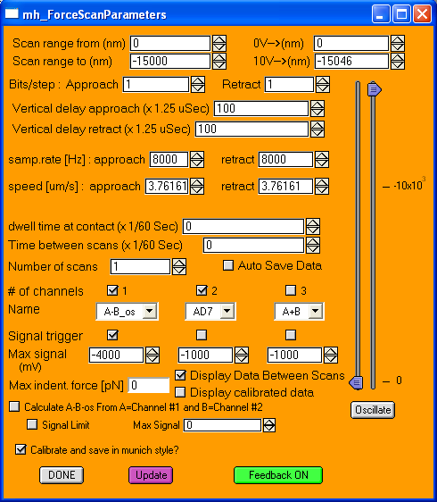



Step 2 – Calibration: Hard Scan
Menu Bar: click DispFScanParameters.
Dwell time: 0
Max signal (mV): -4000
Feedback ON
Click DoForceScan.

Slide 10
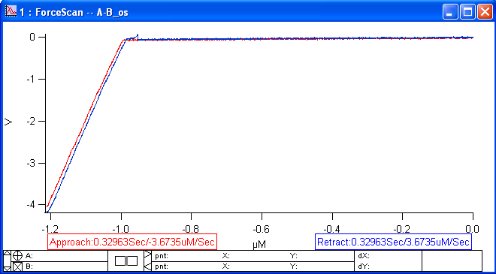
Step 2 – Calibration: Hard Scan
Save at least 5 good Hard Scans.
An example of good Hard Scan.

Slide 11
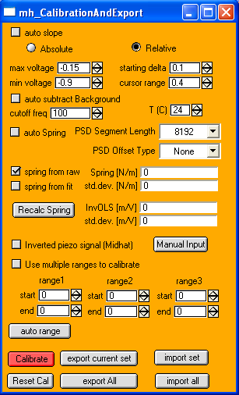




Step 2 – Calibration: Calculation
Click “Calibration & Export”.
Uncheck the followings:
auto slope
auto subtract Background
auto spring
Click Calibrate.

Slide 12
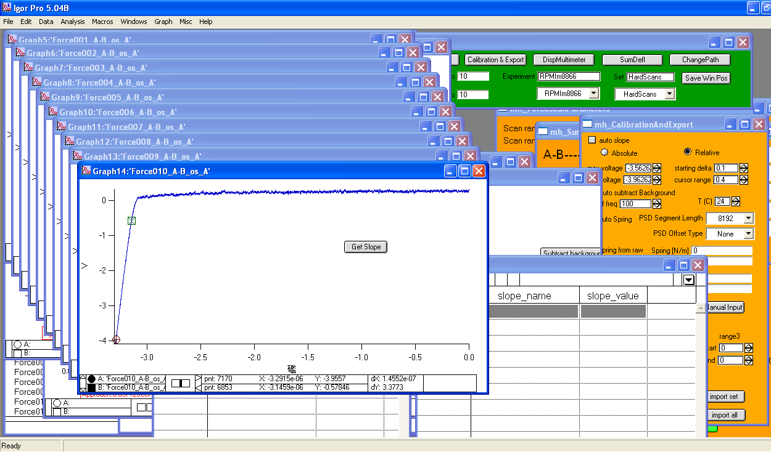

Step 2 – Calibration: Slope
Select two points:
Linear curve between them.
Click “Get Slope”.

Slide 13
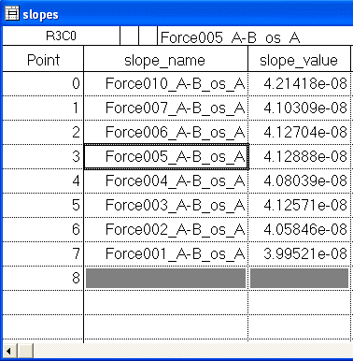
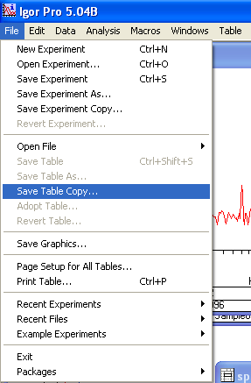
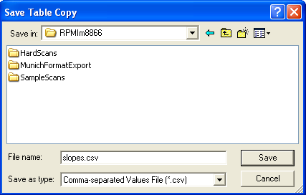
Step 2 – Calibration: Slope
Slope Table:
Values: ~5E-08.
Save as .csv file.

Slide 14
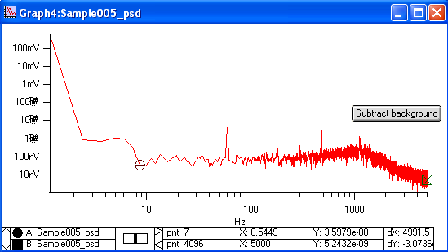
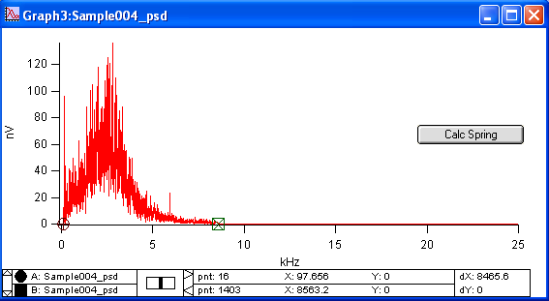
Step 2 – Calibration: Spring
Select two points.
Click “Subtract background”.
Click “Calc Spring”.

Slide 15
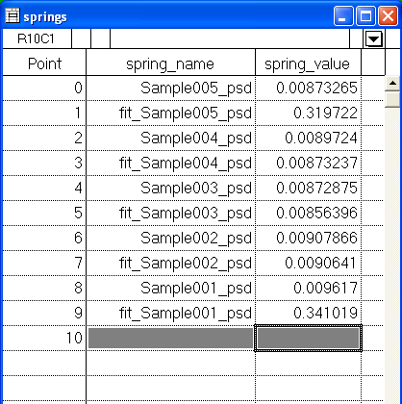
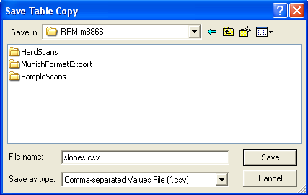
Step 2 – Calibration: Spring
Spring Table:
Values (not fit):
~0.01 for largest triangular cantilever.
Save as .csv file.

Slide 16
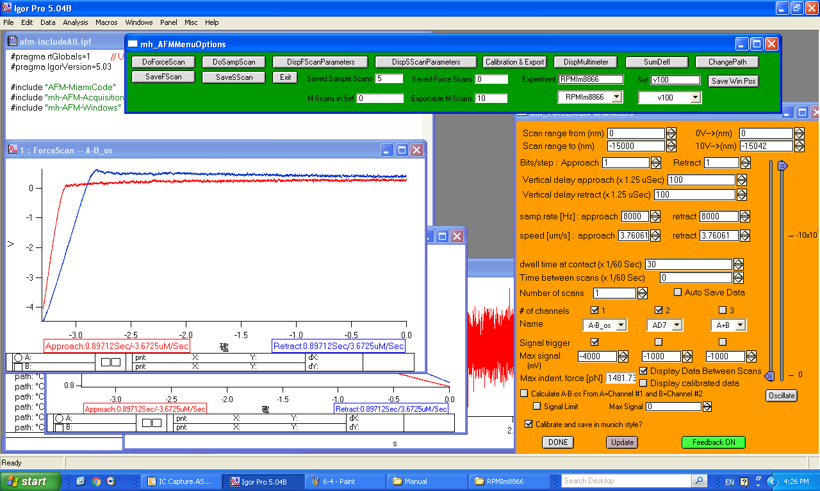

Step 3 – Pulling Experiment
Change data saving folders!
Type the folder name, and press Enter.

